Slide 1
BLACK FRIDAY SALES PROJECT
SUBMITTED BY:
ATISH KALANGUTKAR

Slide 2
Contents
Introduction
Problem Statement
Problem Understanding
What is Black Friday Sales?
Benifits of Black Friday Sales
Data Analysis & Model Building Flowchart
Exploratory Data Analysis (EDA)
Visualizations
Data Analysis Steps Done
Conclusion

Slide 3
INTRODUCTION
The concept of Black Friday originated in the United States and refers to the day after Thanksgiving, which traditionally marks the beginning of the holiday shopping season. Retailers offer steep discounts to attract customers, with the goal of boosting sales and clearing out inventory before the end of the year.Over time, Black Friday has evolved into a global phenomenon, with retailers across the world participating in the event.
Black Friday presents both opportunities and challenges for retailers. On one hand, it can be a lucrative sales event that generates significant revenue and attracts new customers. On the other hand, it requires careful planning and execution to avoid stock outs, manage logistics, and optimize pricing and promotion strategies. Additionally, Black Friday is a highly competitive and dynamic environment, with retailers vying for the attention and wallets of consumers.
To succeed in Black Friday sales, retailers need to understand consumer behavior and preferences, identify trends and patterns, and develop targeted marketing and sales strategies. With the increasing availability of data and advanced analytics tools, retailers can leverage machine learning and statistical techniques to gain insights and make data-driven decisions that can improve their bottom line and enhance the shopping experience for their customers. This project aims to explore a dataset of Black Friday sales to uncover such insights and develop strategies that can help retailers optimize their performance during this critical sales event.

Slide 4
Problem Statement
A retail company “ABC Private Limited” wants to understand the customer purchase behaviour (specifically, purchase amount) against various products of different categories. They have shared purchase summary of various customers for selected high volume products from last month. The data set also contains customer demographics (age, gender, marital status, city_type, stay_in_current_city), product details (product_id and product category) and Total purchase_amount from last month.Now, they want to build a model to predict the purchase amount of customer against various products which will help them to create personalized offer for customers against different products.

Slide 5
What is Black Friday Sales?
Black Friday is a shopping event that takes place the day after Thanksgiving in the United States, which falls on the fourth Thursday of November. It is considered the beginning of the Christmas shopping season, and many retailers offer significant discounts and promotions on their products both in-store and online.
Black Friday sales are highly anticipated by consumers who want to take advantage of the discounts and special offers. The sales typically last for a limited time and include a wide variety of products such as electronics, clothing, home goods, and more. Some retailers even offer doorbuster deals, which are limited-time offers on specific products that are available only in-store and in limited quantities.
Black Friday has become a global phenomenon, with retailers in many countries offering sales and promotions on the same day or in the days leading up to it. In recent years, online retailers have also joined in on the sales frenzy, offering discounts and promotions on their websites.

Slide 6
Benifits of Black Friday Sales
There are several benefits of Black Friday sales for both consumers and retailers:
Discounts and savings: Black Friday sales offer consumers the opportunity to purchase products at discounted prices, often with significant savings. This can be especially beneficial for big-ticket items such as electronics, appliances, and furniture.
Early Christmas shopping: Black Friday sales take place in late November, which is an ideal time for consumers to start their Christmas shopping. The discounts and promotions can help shoppers save money on gifts for their loved ones.
Increased sales for retailers: Black Friday is one of the busiest shopping days of the year, and retailers often see a significant increase in sales during this time. This can help them reach their sales targets and boost their profits.
Clearing inventory: Retailers often use Black Friday sales as an opportunity to clear out their inventory from the previous season or year. This can help them make room for new products and reduce their storage costs.
Creating buzz: Black Friday sales generate a lot of buzz and excitement among consumers, which can help retailers attract new customers and retain existing ones. It can also help build brand awareness and loyalty.
Overall, Black Friday sales can be a win-win situation for both consumers and retailers, with consumers getting great deals and retailers boosting their sales and profits.

Slide 7
Data Analysis And Model Building Flow Chart
Import Libraries
Import Collected Dataset
Data Preprocessing
Label Encoder
Visualizations
(EDA)
Feature Engineering
Checking Correlation
Identifying
Outliers and Skewness

Slide 8
Exploratory Data Analysis (EDA)
Importing required libraries and loading the dataset.
Checked some statistical information such as shape of the dataset,unique values and number of unique values present, type of data present in the columns etc.
Checked for null values and found that there were about 173638 null values present in the column product category 2 and 383247 null values in column product category 3. Further by using median method null values were treated from the dataset.
Also there was one unwanted column named User ID and Product ID which was dropped as it was just having numerical values which was irrelevant at the time of prediction.
While checking for duplicates it was found that there were 5261 duplicates present in the dataset. Further it was dropped from the dataset.
Done feature engineering on column ‘Age’ where 55+ was replaced with age category 55-60 and after that all the age categories was replaced by ‘Child’ for 0-17, ‘Teen’ for 18-25, ‘Adult’ for 26-35, 36-45, 46-50 and for ‘Old’ for 51-55 and 55-60. And also on column stay in current city years it was having + sign, because of that it was showing data type as object. So replaced them by empty spaces and converted the data type to integer.
Than separated categorical and numeric features according to the data types.
◆

Slide 9
Exploratory Data Analysis (EDA) Cont..
Performed uni-variate, bi-variate and multi-variate analysis by plotting Dist plot, Count plot, Pie plot, Bar plot and Line plot.
Than checked for Top 100 highest priced products from the dataset and Cheapest 100 priced products.
Encoded the categorical features by using Label encoded method.
Used bar plot to check the correlation between the features and the label and after with the help of heatmap checked whether there is multicollinearity present or not among the features. So found that there was no multicollinearity problem within the features.
Checked whether there are any outliers present or not using box plot on numerical data columns and found that in column Product category 1 and product category 3 was having outliers so by using z-score method removed outliers.
Checked for skewness on numerical data columns and found that column Product category 1 and product category 3 was having skewness, so by using power transform method treated the skewness of that particular columns.
Separated feature and label data and than feature scaling was done by using power transform method to avoid any kind of data biasness.
After plotting heatmap, it was seen than there was no multicollinearity problem within the features, but just to cross verify vif method was used. After using vif method it was found that all the columns values were below 5. So it was confirmed that there was no multicollinearity problem within the features.

Slide 10
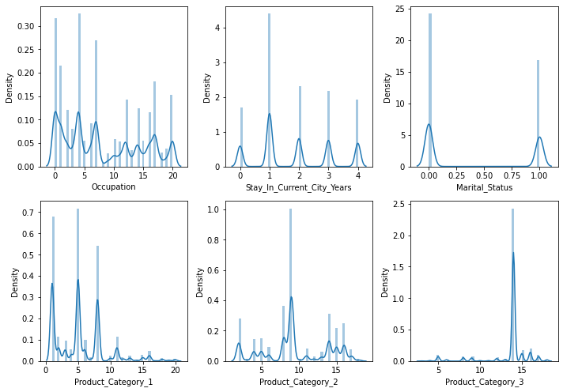
Visualization
By looking at the plots we can see that:
So in all three column i can see skewness as th data is not normally distributed. So to cross verify it io further i will check the skewness.
It can can be seen that outliers also can be present in all three columns which will be cross verify with the help of box plots.
Dist plots

Slide 11
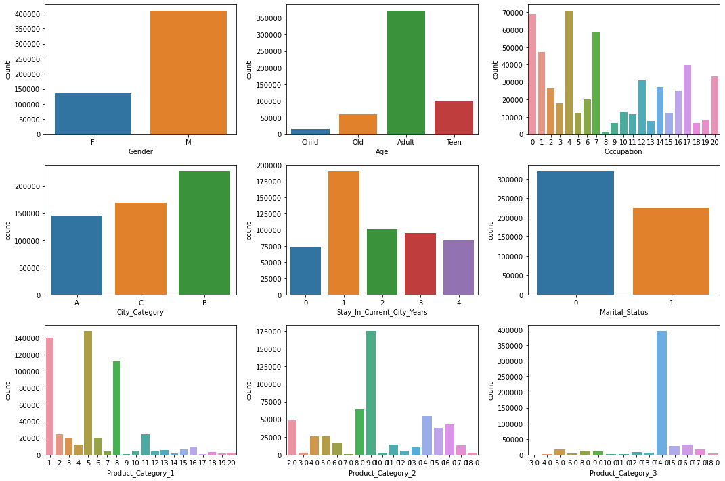
Visualization Cont..
By looking at the plots we can see that:
In plot Gender we can see that the male users are more than the female users.
In plot Age we can see that most of the users are Adult as compared to other age category.
In plot Occupation most of the users h=are having value as 4.
In the plot City category we can see that most of the users are from city category B.
In the plot stay in current city years most of the users are staying in a particular city from past one year.
In the plot product category 1, most of the users are purchasing product having value as 5 followed by 1 and 8.
In the plot product category 2, most of the users are purchasing product having value as 9.0.
In the plot product category 3, most of the users are purchasing product having value as 14.0.
Count Plots

Slide 12
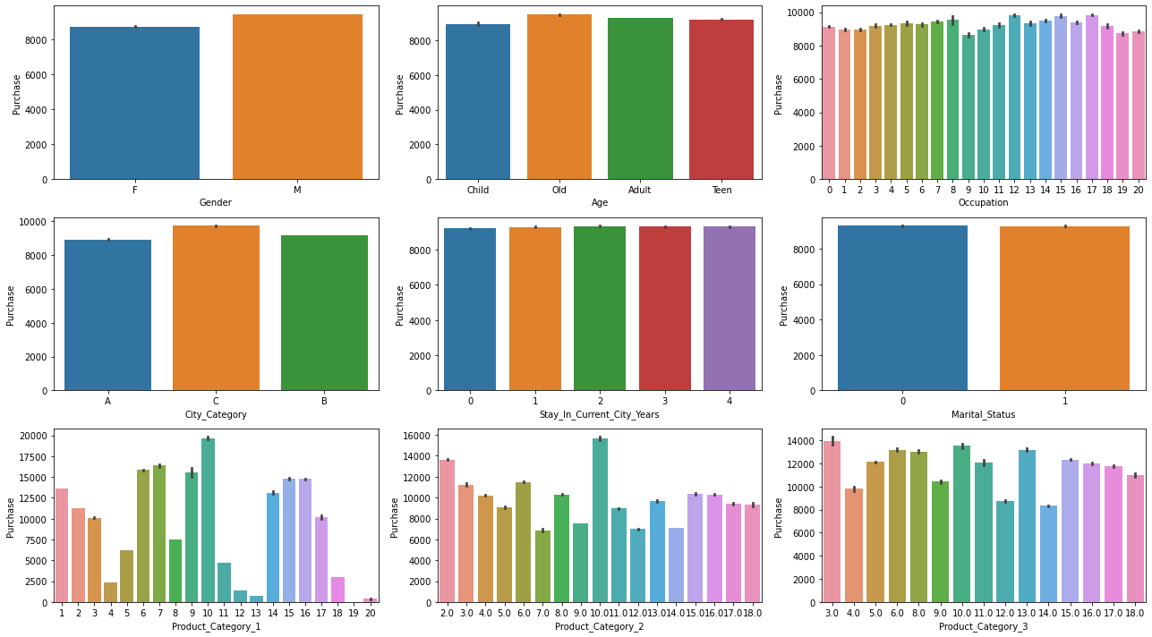
Visualization Cont..
By looking at the plots we can see that:
In the above plot Gender vs Purchase we can see that Male users have purchased more than the Female users.
In the above plot Age vs Purchase we can see that users which are old have purchased more as compared to other age category users.
In the above plot Occupation vs Purchase we can see that users with occupation value as 12, 15 and 17 have purchased more.
In the above plot City category vs Purchase we can see that users from city category C have purchased more than that of other city categories.
In the above plot stay in current city in years vs Purchase we can see that users staying their particular cities from past 0, 1, 2, 3, and 4 years have purchased equally.
In the above plot Marital status vs Purchase we can see that both the users who are married as well as who are not married have purchase equally.
In the above plot Product category 1 vs Purchase users have purchased more with value 10 from product category 1.
In the above plot Product category 2 vs Purchase users have purchased more with value 10 from product category 2.
In the above plot Product category 3 vs Purchase users have purchased more with value 3.0 from product category 3.
Bar Plots

Slide 13
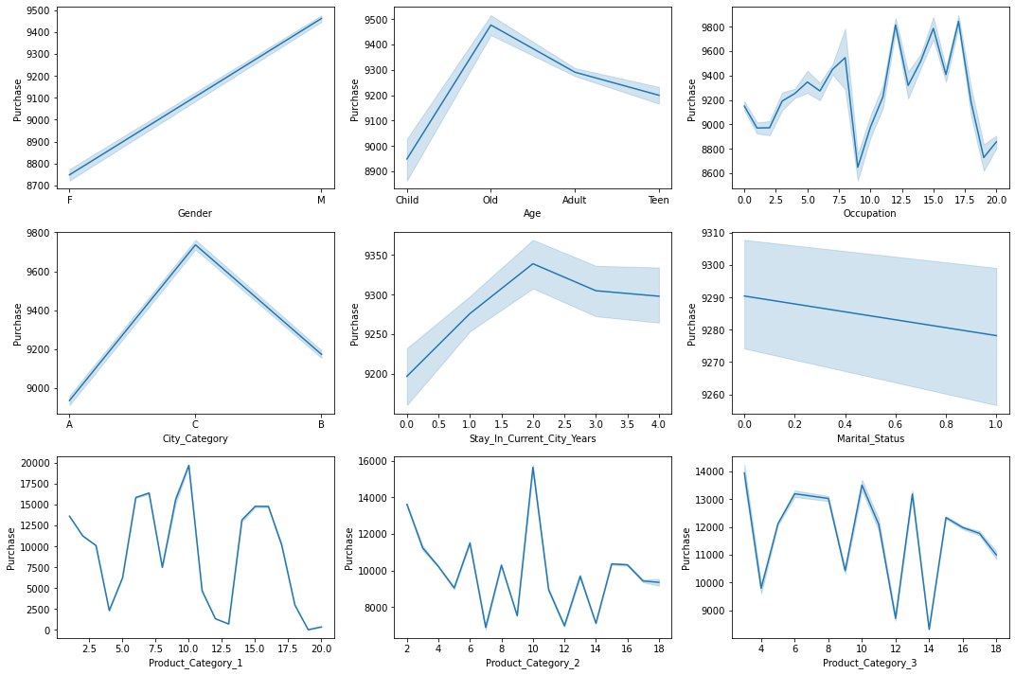
Visualization Cont..
By looking at the plots we can see that:
In the above plot Gender vs Purchase we can see that Male users have purchased more than the Female users.
In the above plot Age vs Purchase we can see that users which are old have purchased more as compared to other age category users.
In the above plot Occupation vs Purchase we can see that users with occupation value as 12, 15 and 17 have purchased more.
In the above plot City category vs Purchase we can see that users from city category C have purchased more than that of other city categories.
In the above plot stay in current city in years vs Purchase we can see that users staying in their particular cities from past 2 years have purchased more.
In the above plot Marital status vs Purchase we can see that both the users who are not married have purchase more than the users which are married.
In the above plot Product category 1 vs Purchase users have purchased more with value 10 from product category 1.
In the above plot Product category 2 vs Purchase users have purchased more with value 10 from product category 2.
In the above plot Product category 3 vs Purchase users have purchased more with value 3.0 from product category 3.
Line Plots:

Slide 14
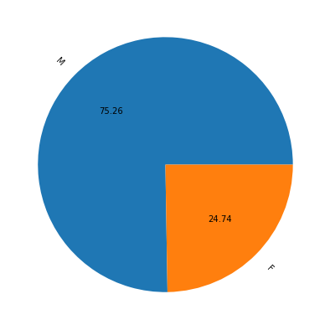
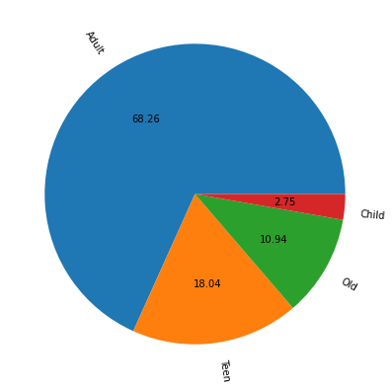
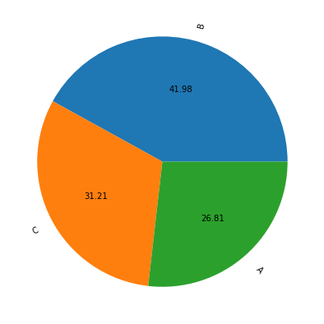
Visualization Cont..
1
2
3
Pie Plots
By looking at the plots we can see that:
1: From the above plot we can see that Male users are more than that of female users.
2: From the above we can see that Users are more from B city category.
3: From the above plot we can see that Adult users are more than that of other age category users.

Slide 15
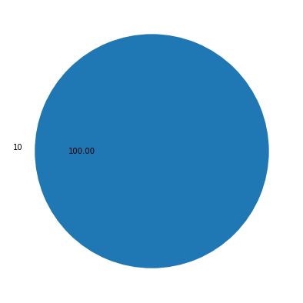
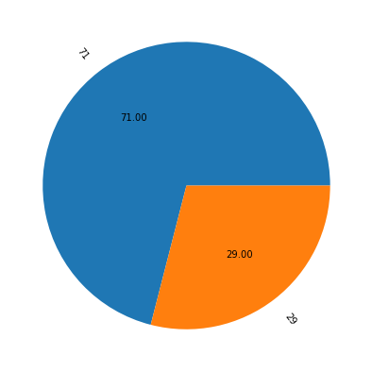
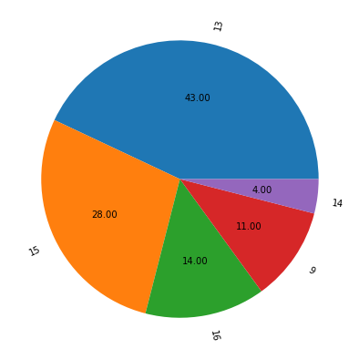
Visualization Cont..
1
2
3
Top 100 highest priced products Pie Plots
By looking at the plots we can see that:
1: From the above plot we can see most of the highest priced product from product category 1 is with value 10.
2: From the above plot we can see most of the highest priced product from product category 2 is with value 13.
3: From the above plot we can see most of the highest priced product from product category 3 is with value 71.

Slide 16
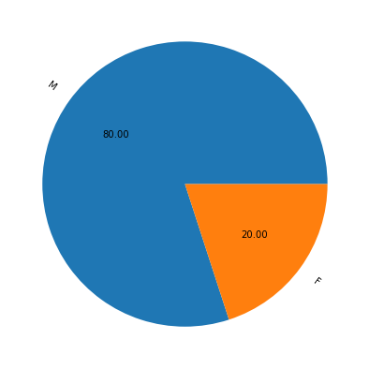
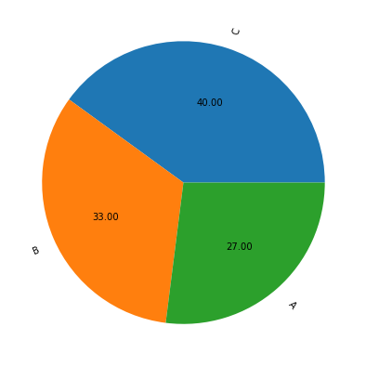
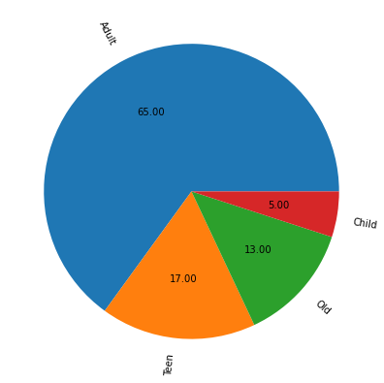
Visualization Cont..
1
2
3
Top 100 highest priced products Pie Plots
By looking at the plots we can see that:
1: From the above plot we can see most of the highest priced product are purchased more by male users.
2: From the above plot we can see most of the highest priced product are purchased more by Adult users.
3: From the above plot we can see most of the highest priced product are purchased more users from city category C.

Slide 17
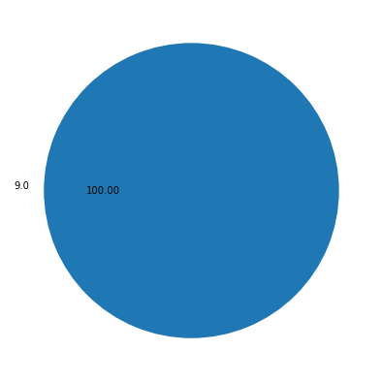
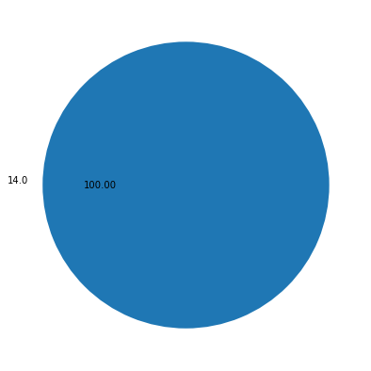

Visualization Cont..
1
2
3
Cheapest 100 priced products Pie Plots
By looking at the plots we can see that:
1: From the above plot we can see most of the lowest priced product from product category 1 is with value 19.
2: From the above plot we can see most of the lowest priced product from product category 2 is with value 9.0.
3: From the above plot we can see most of the lowest priced product from product category 3 is with value 14.0.

Slide 18
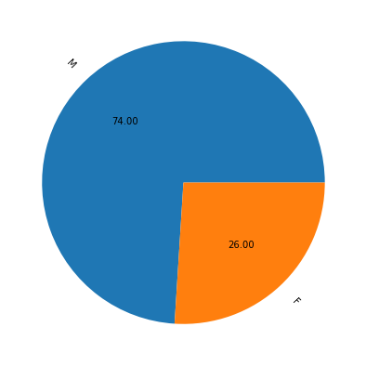
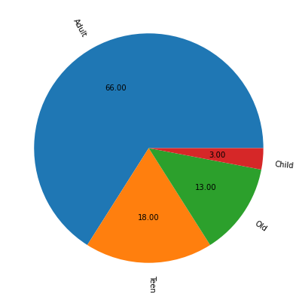
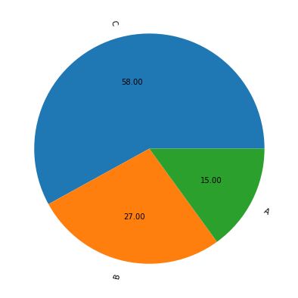
Visualization Cont..
1
2
3
Cheapest 100 priced products Pie Plots
By looking at the plots we can see that:
1: From the above plot we can see most of the lowest priced product are purchased more by male users.
2: From the above plot we can see most of the lowest priced product are purchased more by Adult users.
3:From the above plot we can see most of the lowest priced product are purchased more by users from city category C..

Slide 19
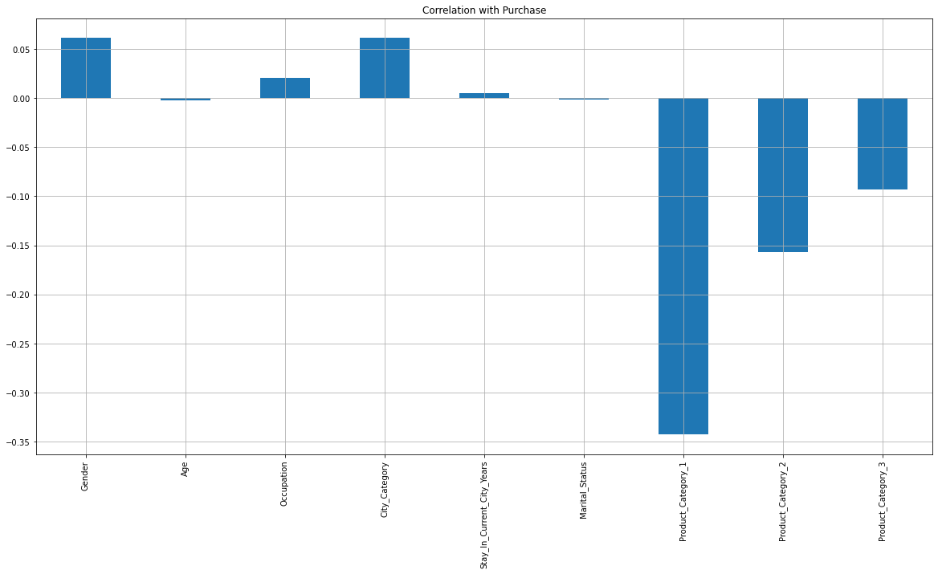
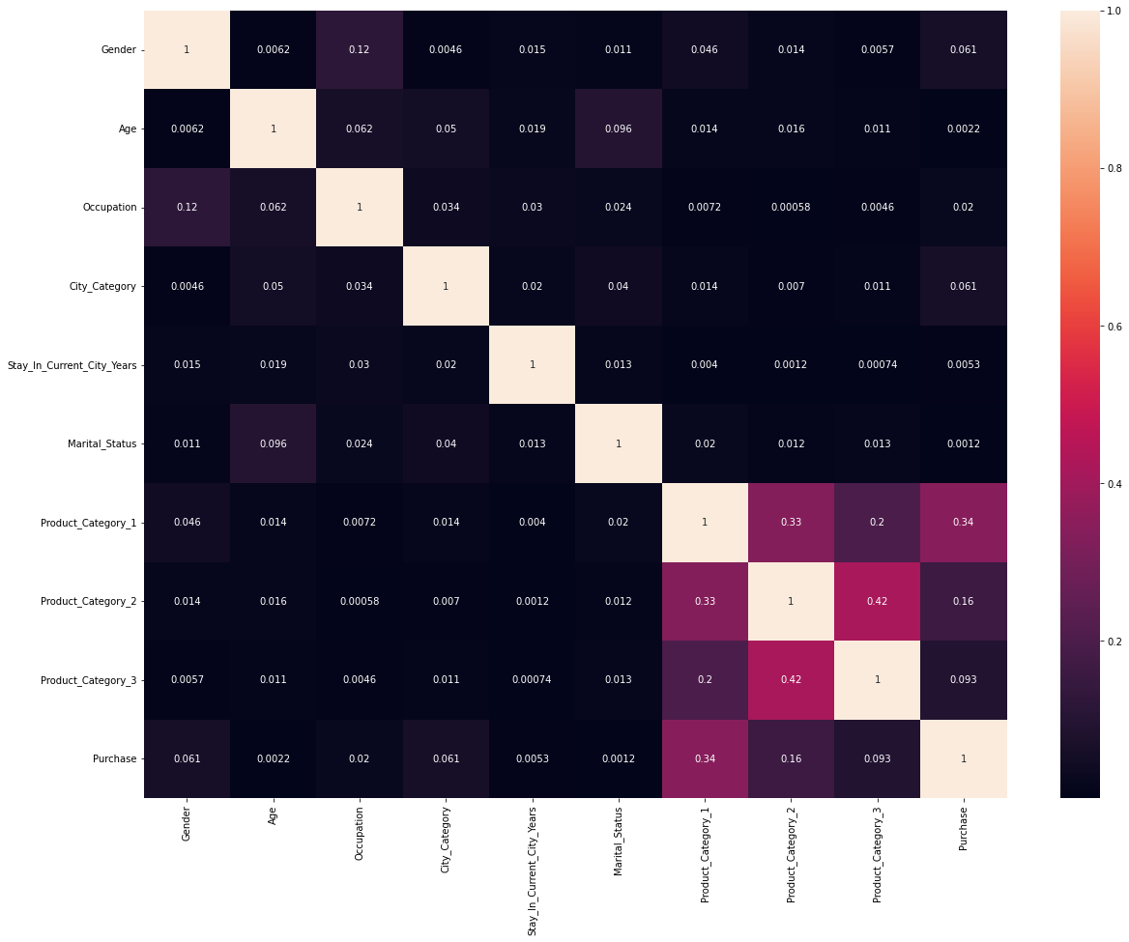
Correlation Between Features And Label
Bar Plot
HeatMap
By looking at the bar plot we can see that features are positively as well as negatively correlated with the label.
By looking at the heatmap we can see if there is any multicollinearity problem between the Features.

Slide 20
Data Analysis Steps Done
Encoded the categorical column data by using Lable Encoder.
To visualize the correlation between the Features and Label and multicollinearity problem i have used bar plot, line plot and heatmap.
Used Box plot to check whether there are outliers present or not in continuous data columns. Further found that in two columns outliers were present which were later on removed by using z-score method.
Skewness was checked and found that in two columns skewness was present so later on it was treated with the help of power transform method.
Used Standard Scaler method to standardize the data.

Slide 21
Conclusion
From our detailed analysis we can determine the following:
Most of the users are purchasing product having value as 5 followed by 1 and 8 from the product category 1.
Most of the users are purchasing product having value as 9.0 from the product category 2.
Most of the users are purchasing product having value as 14.0 from the product category 3.
From product category 1, the purchased amount is highest of product having value as 10.
From product category 2, the purchased amount is highest of product having value as 10.0.
From product category 3, the purchased amount is highest of product having value as 3.0.

Slide 22
THANK YOU！

